Slide 1

SECURING ELECTRONIC VOTING SYSTEM
USING
BLOCKCHAIN TECHNOLOGY
Prepared by : Ika Syafika binti Rozak
Supervisor : Mohammad Hafidz bin Rahmat
CSP Lecture : Mohd Hafifi Mohd Supir

Slide 2
Current problem with E-voting
Vote privacy and anonymity, ballot irrevocability and transparency throughout the vote counting process (Bartolucci, 2018).
It is possible to change the data inside the database which can harm the result of vote (Hanifatunnisa ,2017).
Distributed Denial of Service (DDoS) attacks can harm the software, servers or database used (Yavuz, 2018).

Slide 3
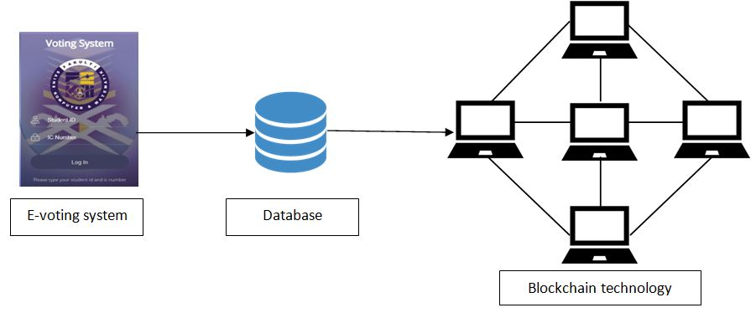
Objectives
Method objective 1
To study existing electronic voting system structure and efficiency.
To design an electronic voting system with blockchain technology concept ideas and architecture.
To evaluate the dependability of blockchain-based online voting system.
The study of the existing e-voting system is based on the journals and researchers.
Method objective 2
The design of the e-voting system with blockchain is based on the above architecture.
Method objective 3
The dependability of the blockchain is evaluate based on the security level of the data and data integrity.

Slide 4
Significance
E-voting system make casting a vote becomes easier, convenient hence increase the number of voter.
To mitigate the dishonesty and corruption as the voting procedure on blockchain technology is auditable after election.
Provide a more secured data security as it uses encryption (SHA-256) algorithm in the database.
Data of the votes cannot be manipulated. Thus, making user feels safe and comfortable to vote.

Slide 5
Thank you

